Slide 1
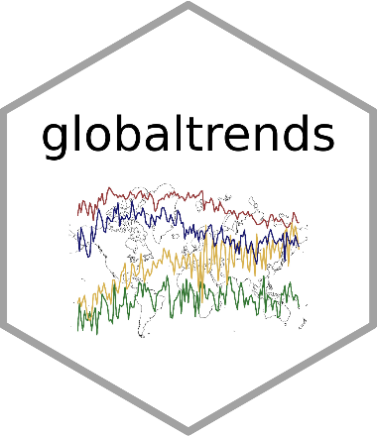
Let Me Google That for You Measuring global trends using Google Trends
Harald Puhr & Jakob Müllner
useR! – 2021-07-06

Slide 2
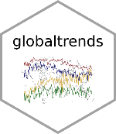
Agenda
What does globaltrends do?
What can you do with globaltrends?
Why should you care?

Slide 3
1
What does globaltrends do?

Slide 4
The globaltrends package
The globaltrends package allows users to download and analyze the dispersion and development of global trends with data from Google Trends
Functions to download and compute data
Functions to export data
Functions to visualize data
Data storage in SQLite file
“One stop solution” to work with data from Google Trends
Available on GitHub: https://github.com/ha-pu/globaltrends
Code example enclosed

Slide 5
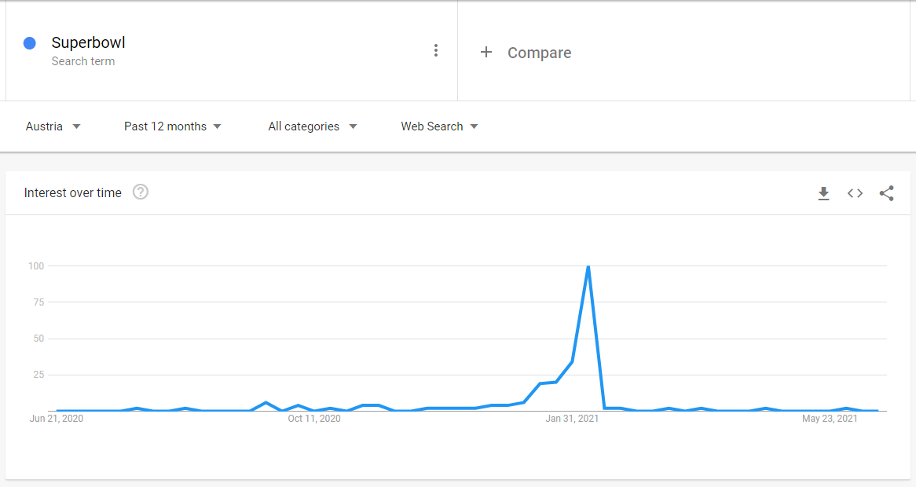
Google Trends…
https://trends.google.com/trends/explore?geo=AT&q=Superbowl

Slide 6
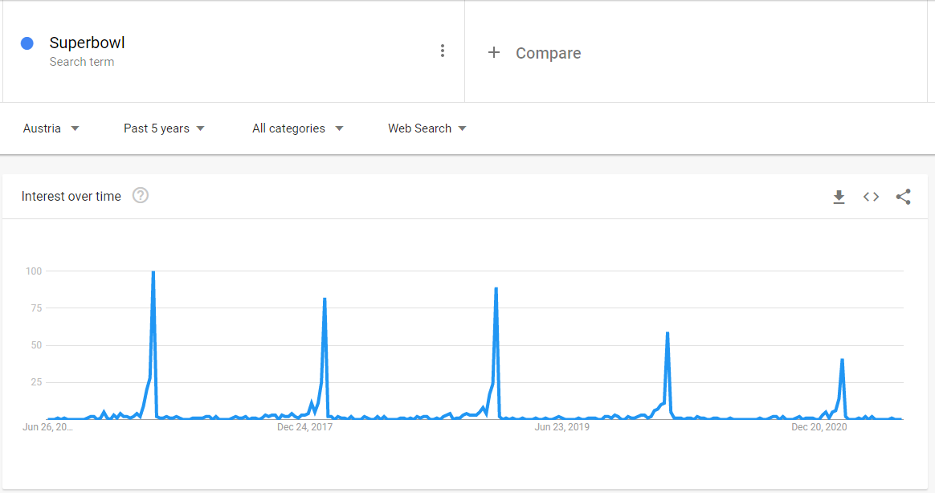
…normalizes data based on time…
https://trends.google.com/trends/explore?date=today%205-y&geo=AT&q=Superbowl

Slide 7
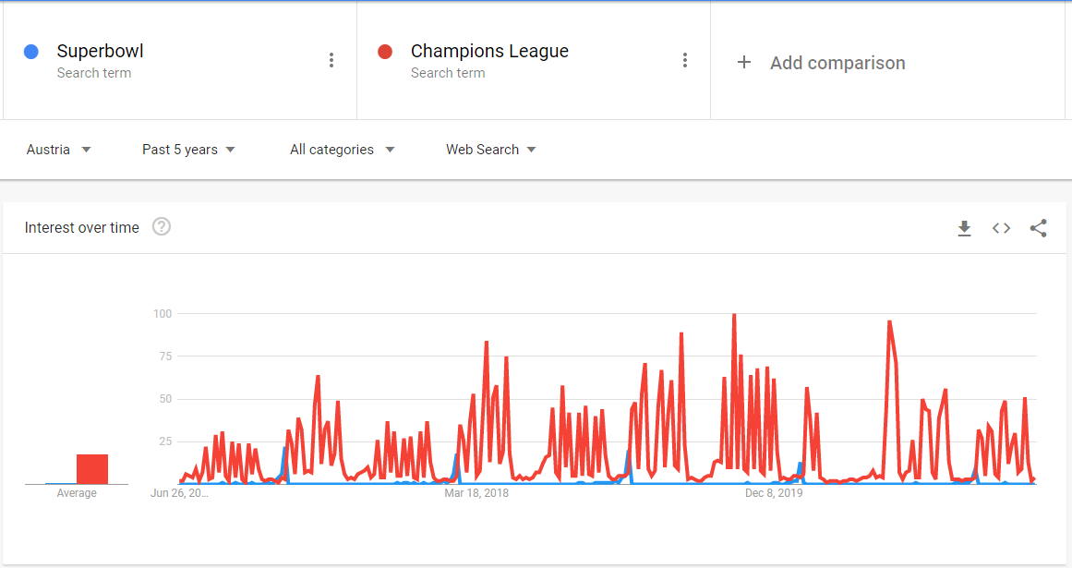
…and keyword combination
https://trends.google.com/trends/explore?date=today%205-y&geo=AT&q=Superbowl

Slide 8
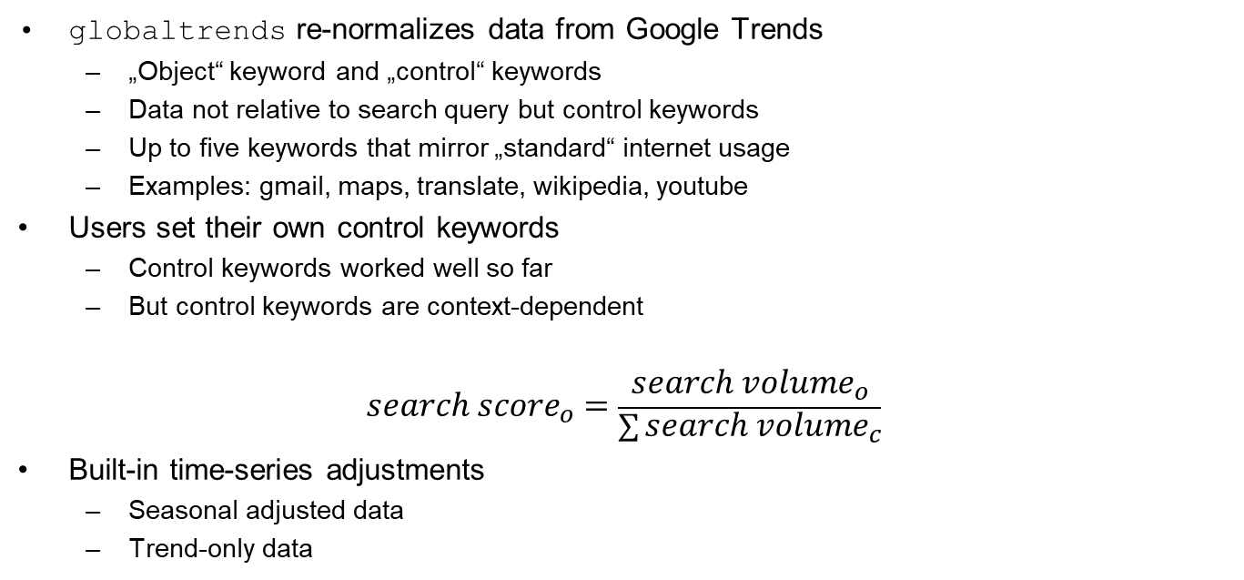
Solution: re-normalization
globaltrends re-normalizes data from Google Trends
„Object“ keyword and „control“ keywords
Data not relative to search query but control keywords
Up to five keywords that mirror „standard“ internet usage
Examples: gmail, maps, translate, wikipedia, youtube
Users set their own control keywords
Control keywords worked well so far
But control keywords are context-dependent
$${search score}_{o}=\frac{{search volume}_{o}}{\sum{{search volume}_{c}}}$$
Built-in time-series adjustments
Seasonal adjusted data
Trend-only data

Slide 9
Two measures for internationalization
Degree of internationalization: dispersion of search scores
Indicator for equality of search volumes across locations
Inverted Gini coefficient
Inverted Herfindahl index
Inverted entropy
Unweighted data
Volume of internationalization: global search scores
Indicator for total amount of search volumes
Weighted data

Slide 10
globaltrends workflow
Setup
initialize_db(), start_db(), disconnect_db(),
add_control_keyword(), add_object_keyword()
Download data
download_control(), download_control_global()
download_object(), download_object_global()
Compute data
compute_score(), compute_voi(), compute_doi()
Export data
export_score(), export_voi(), export_doi()
Visualize data
plot_bar(), plot_ts(), plot_box()

Slide 11
2
What can you do with globaltrends?

Slide 12
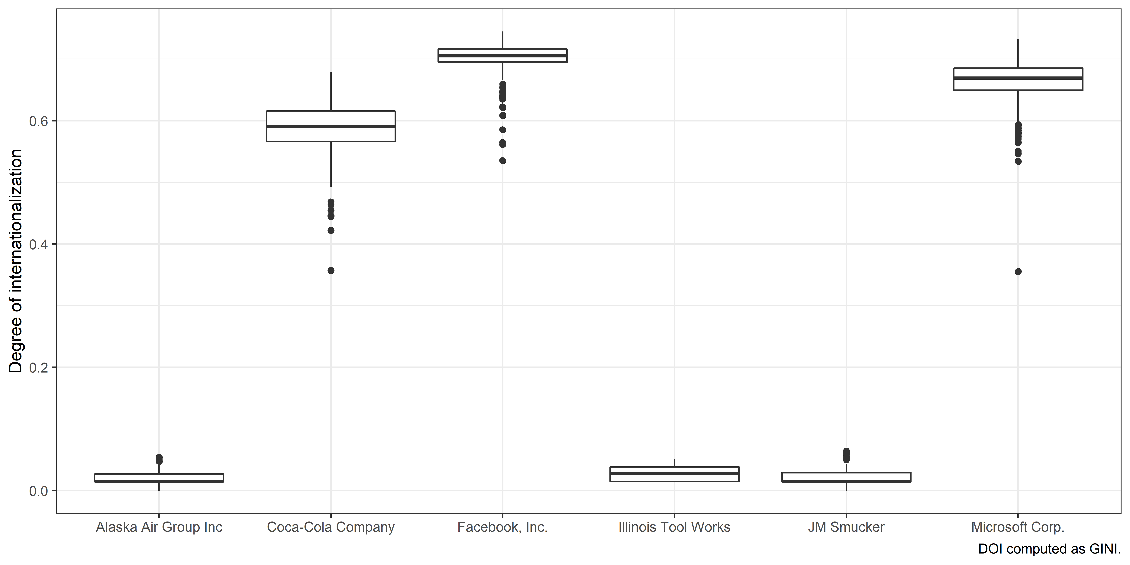






Internationalization of firms

Slide 13
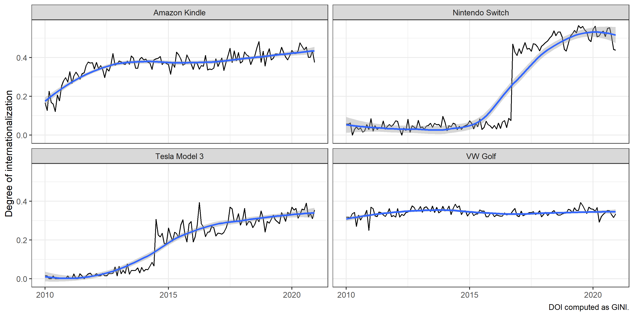


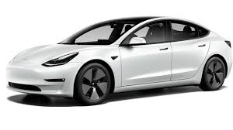
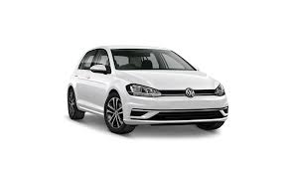
Internationalization of products

Slide 14
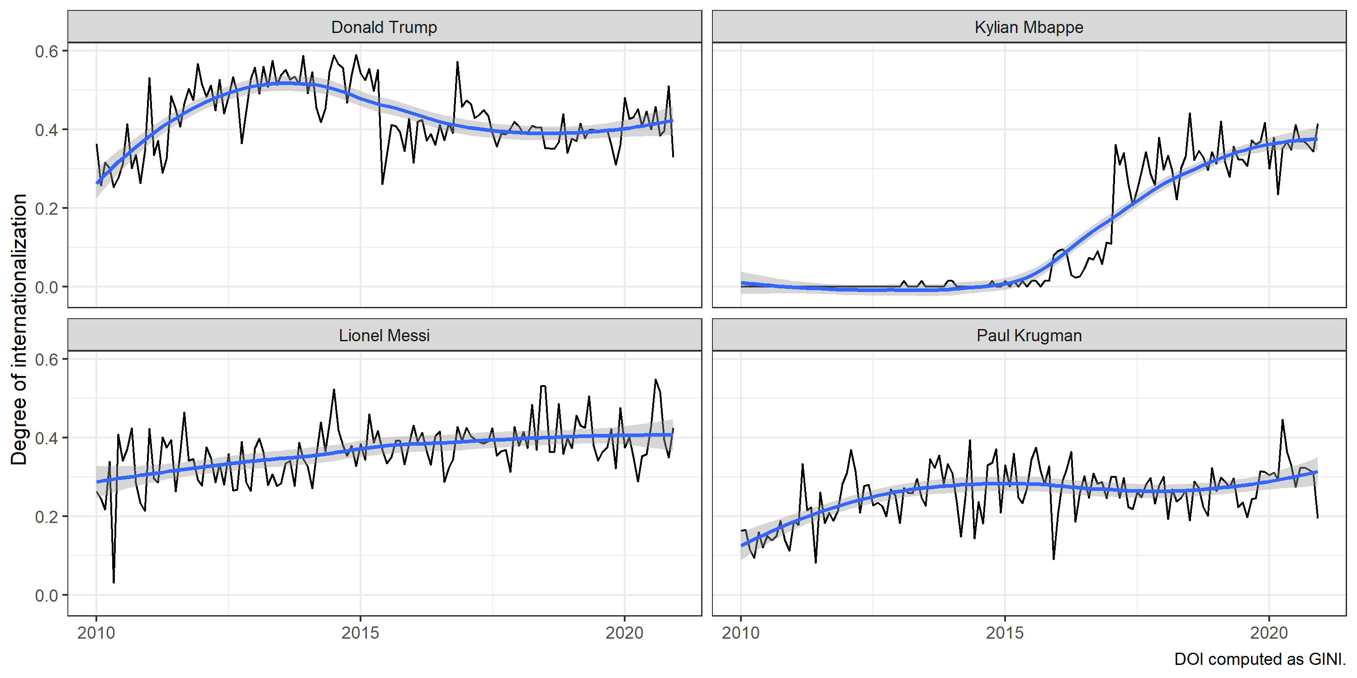




Internationalization of individuals

Slide 15
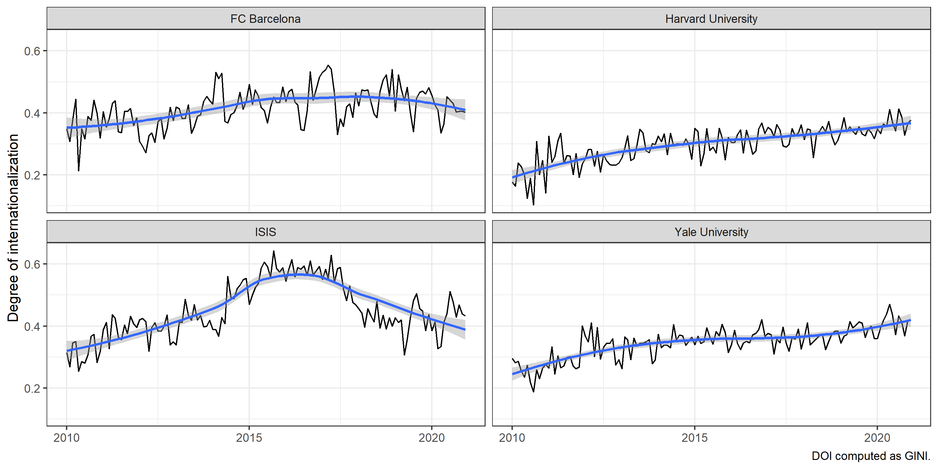




Internationalization of non-corporate organizations

Slide 16
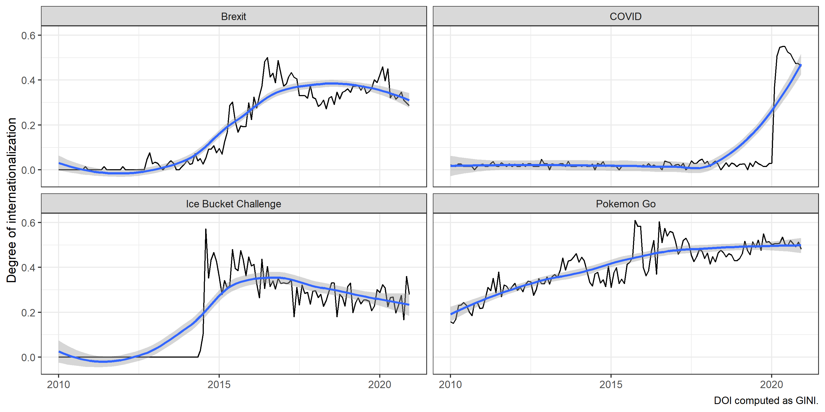




Internationalization of trends and phenomena

Slide 17


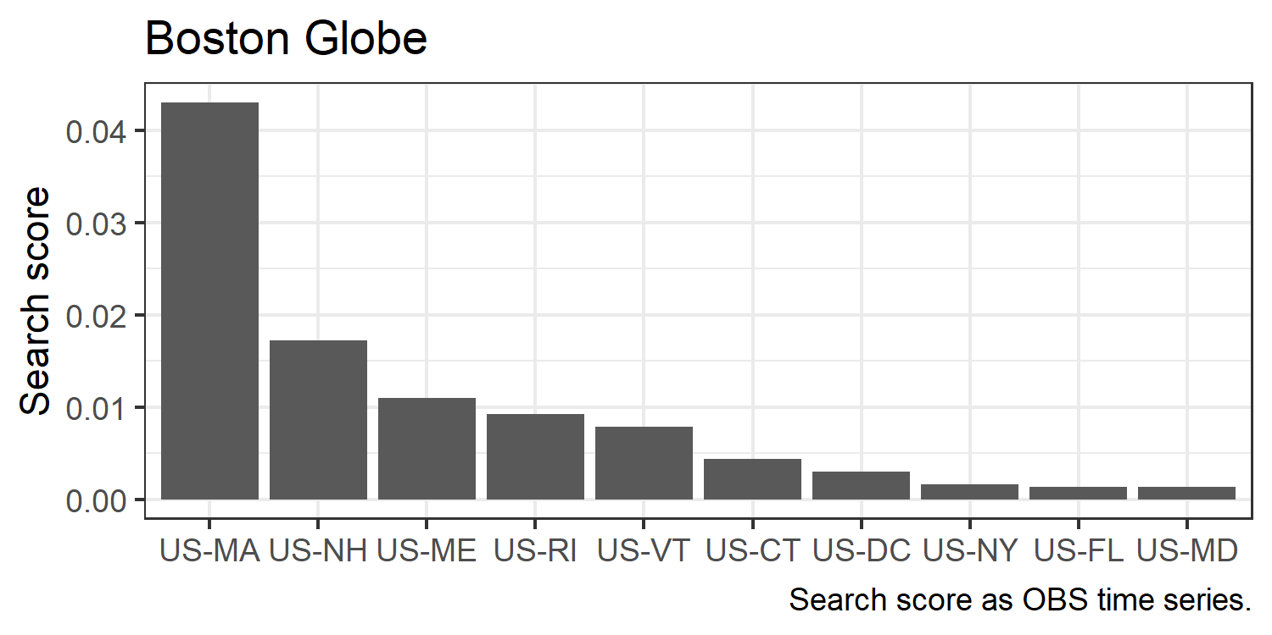
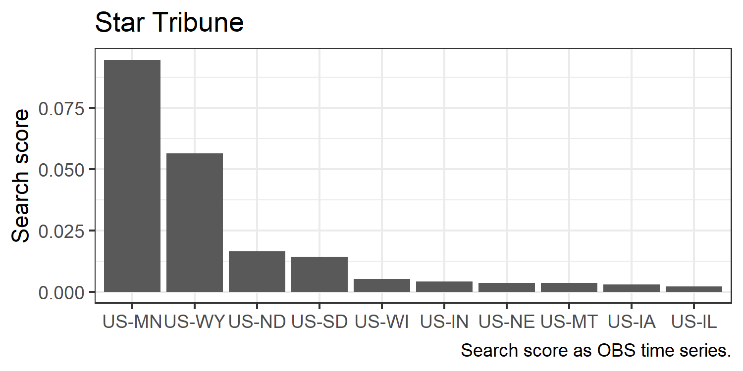


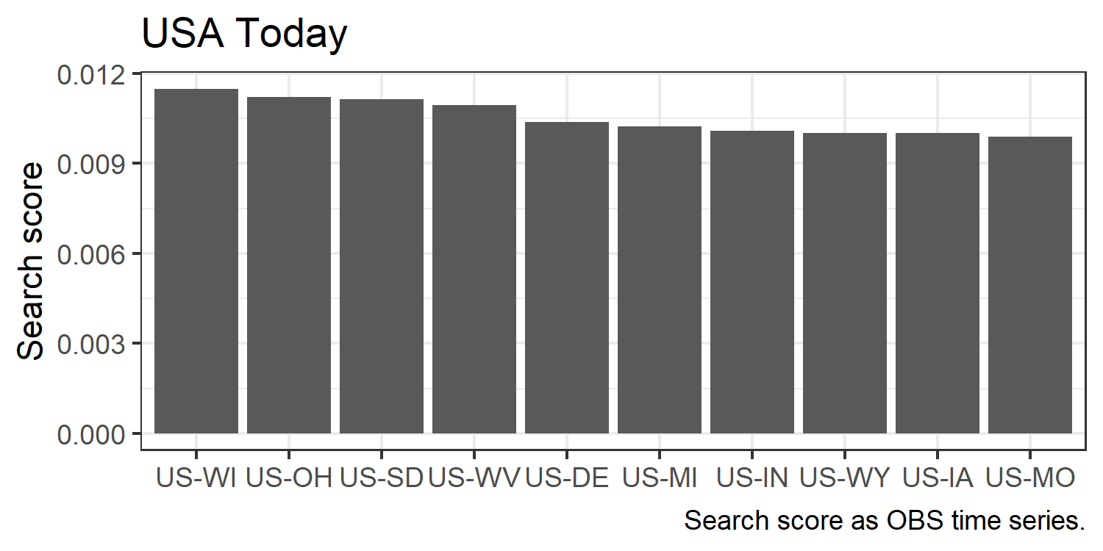
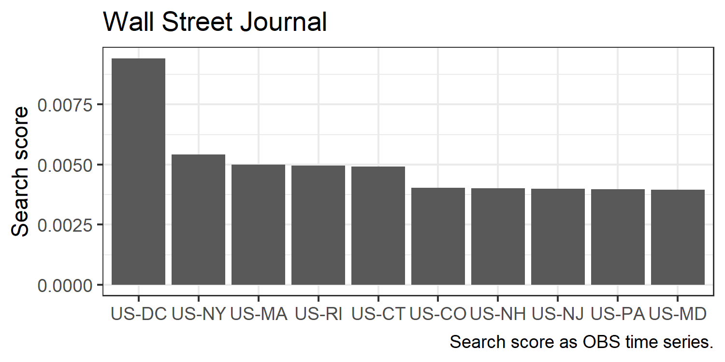
Within-country dispersion

Slide 18
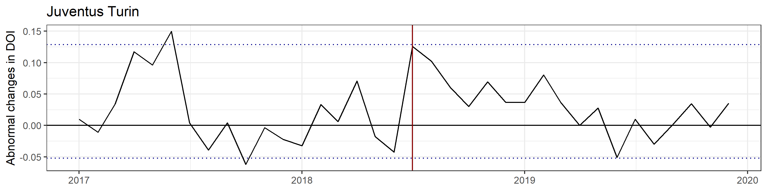


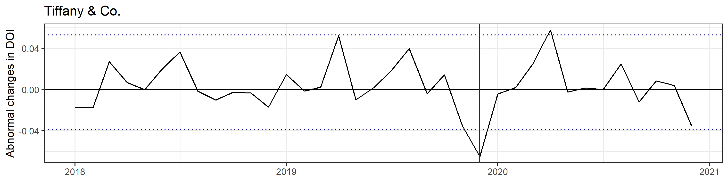

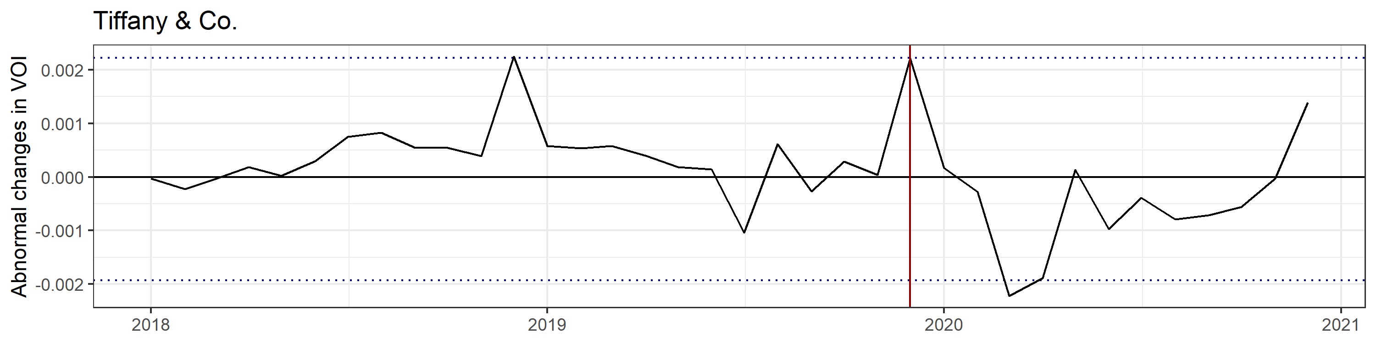

Event studies
Cristiano Ronaldo Transfer
Announced
acquisition by LVMH

Slide 19
3
Why should YOU care?

Slide 20
Why you should care about globaltrends…
Academics and practitioners
Access to Google Trends as amazing data source
Re-normalization allows large scale data analysis
SQLite database to share data
R users
We do not replace gtrendsR -> we use gtrendsR
System of functions that build around data accessed through gtrendsR
“One stop solution”
R developers
Who is your average user?
Most people in academia do not use R -> they cope with R
Make the package comfortable for the type of user you target

Slide 21
Thank you!
Package and documentation available on GitHub:
https://github.com/ha-pu/globaltrends
globaltrends is work in progress:
Comments, suggestions, bug reports, recommendations are highly welcome and appreciated!

Slide 22
Q&A

Slide 23
Jakob Müllner
Harald Puhr
Institute of International Business
Vienna University of Economics and Business
E-Mai: jakob.muellner@wu.ac.at
E-Mai: harald.puhr@wu.ac.at

Slide 24
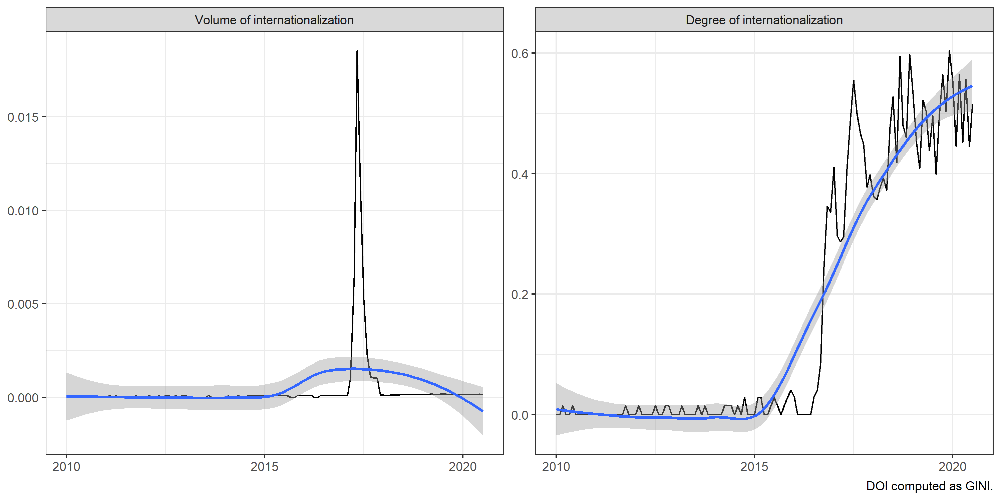
Fidget Spinner example DOI vs. VOI

Slide 25
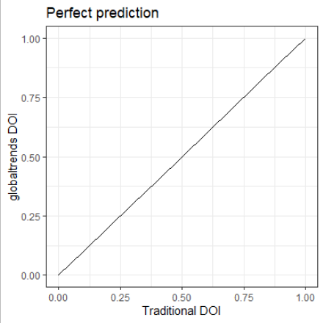
Predictive Robustness
To test for biases we create a predictive model and predict global trends DOI with traditional DOI measures
Compound of RIMS, TNCI, FSTS
Number of foreign countries with subsidiaries
Share of foreign subsidiaries
A perfect predictive relationship would yield
β =1 and
R² = 1
To test for biases, we interact covariates for potential sources of bias
Language, Internet usage, China….

Slide 26
Predictive Robustness
 | globaltrends DOI
 | (1) | (2) | (3)
Traditional DOI | 0.259***
 | p = 0.000
Number of foreign countries |  | 0.338***
 |  | p = 0.000
Share of foreign subsidiaries |  |  | 0.135***
 |  |  | p = 0.000
Constant | 0.269*** | -0.001 | -0.002
 | p = 0.000 | p = 0.964 | p = 0.940
Observations | 1,103 | 1,025 | 1,025
Dataset fixed effects | Included
R² | 0.150 | 0.114 | 0.018
Adjusted R² | 0.148 | 0.113 | 0.017
Predictive validity and reliability of traditional measures is significant and positive in all specifications
Traditonal DOI
Number of foreign countries
Share of foreign subsidiaries
However, coefficients and R² indicate conceptual differences

Slide 27
Country biases
 | globaltrends DOI
 | (4) | (5) | (6) | (7) | (8)
Traditional DOI | 0.371*** | 0.224*** | 0.223*** | 0.370*** | 0.427***
 | p = 0.000 | p = 0.000 | p = 0.000 | p = 0.000 | p = 0.000
GDP | 0.049***
 | p = 0.008
GDP/capita |  | 0.332***
 |  | p = 0.001
Internet usage |  |  | 0.077
 |  |  | p = 0.605
English proficiency |  |  |  | 0.054
 |  |  |  | p = 0.190
English as official language |  |  |  |  | 0.187***
 |  |  |  |  | p = 0.019
Traditional DOI x GDP | -0.034**
 | p = 0.034
Traditional DOI x GDP/capita |  | 0.053
 |  | p = 0.521
Traditional DOI x Internet usage |  |  | 0.092
 |  |  | p = 0.506
Traditional DOI x English proficiency |  |  |  | -0.185***
 |  |  |  | p = 0.000
Traditional DOI x English as official language |  |  |  |  | -0.236***
 |  |  |  |  | p = 0.000
Constant | 0.057 | 0.110* | 0.238*** | 0.217*** | 0.086
 | p = 0.521 | p = 0.077 | p = 0.002 | p = 0.000 | p = 0.326
Observations | 1,096 | 1,096 | 1,098 | 1,089 | 1,099
Dataset fixed effects | Included
R² | 0.161 | 0.161 | 0.152 | 0.171 | 0.164
Adjusted R² | 0.157 | 0.157 | 0.148 | 0.167 | 0.161
We observe very small home country size bias
DOI measures are biased towards English speaking and English proficient countries
Language biases do not compromise predictive validity and can be controlled with dummy variable for English native language

Slide 28
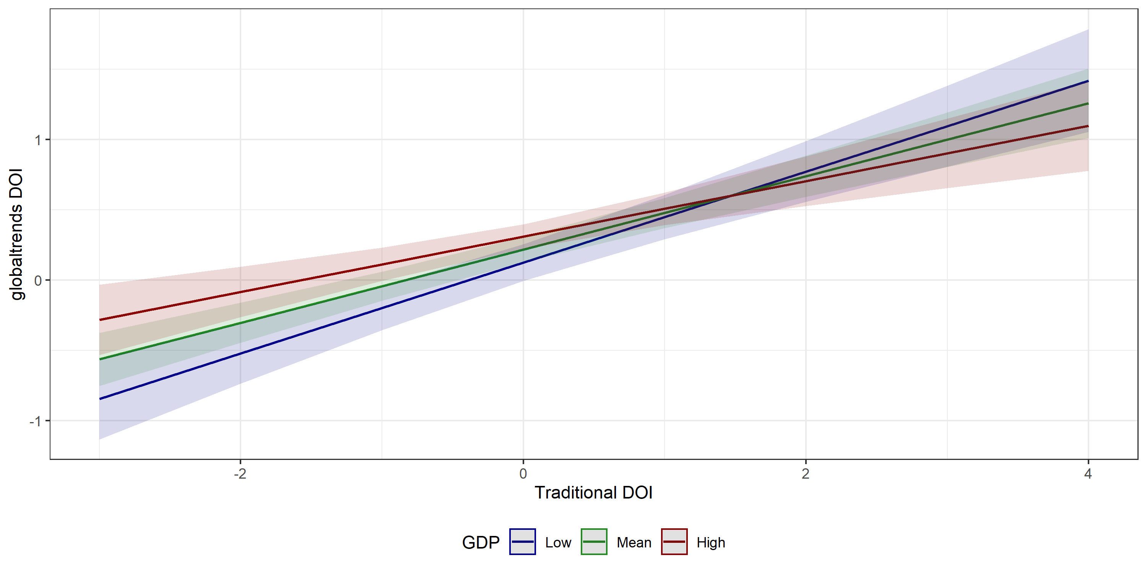
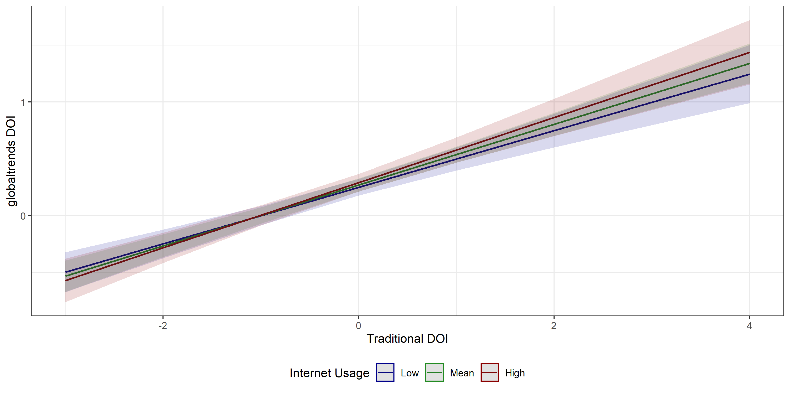
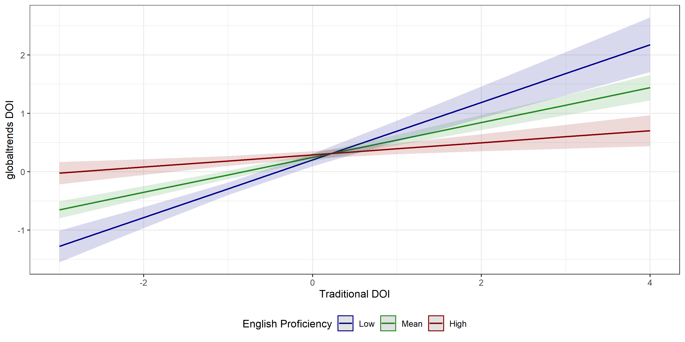
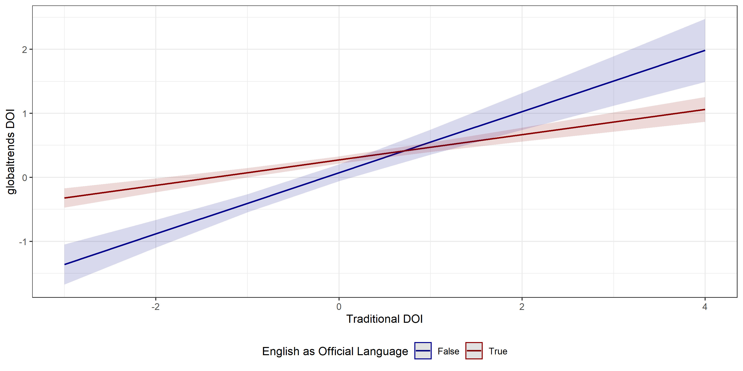
Home country biases
Home country size (GDP)
Internet usage
English proficiency
English native

Slide 29
Firm biases
 | globaltrends DOI
 | (9) | (10) | (11) | (12) | (13)
Traditional DOI | 0.273*** | 0.265*** | 0.280*** | 0.343*** | 0.258***
 | p = 0.000 | p = 0.000 | p = 0.000 | p = 0.000 | p = 0.000
Total sales | 0.322***
 | p = 0.000
Number of employees |  | 0.268***
 |  | p = 0.000
Total assets |  |  | 0.248***
 |  |  | p = 0.000
B2B industry |  |  |  | -0.019
 |  |  |  | p = 0.825
Exposure to China |  |  |  |  | -0.097**
 |  |  |  |  | p = 0.043
Traditional DOI x Total sales | 0.073***
 | p = 0.003
Traditional DOI x Number of employees |  | 0.104***
 |  | p = 0.001
Traditional DOI x Total assets |  |  | 0.174***
 |  |  | p = 0.001
Traditional DOI x B2B industry |  |  |  | -0.097
 |  |  |  | p = 0.244
Traditional DOI x Exposure to China |  |  |  |  | -0.022
 |  |  |  |  | p = 0.547
Constant | 0.265*** | 0.253*** | 0.268*** | 0.300*** | 0.244***
 | p = 0.000 | p = 0.000 | p = 0.000 | p = 0.000 | p = 0.000
Observations | 1,077 | 1,074 | 1,075 | 1,093 | 1,084
Dataset fixed effects | Included
R² | 0.238 | 0.205 | 0.174 | 0.152 | 0.153
Adjusted R² | 0.234 | 0.202 | 0.170 | 0.148 | 0.149
We observe a small bias for firm size
DOI measures not affected by B2B operations and exposure to China
Size bias does not compromise predictive validity and can be controlled with firm size controls

Slide 30
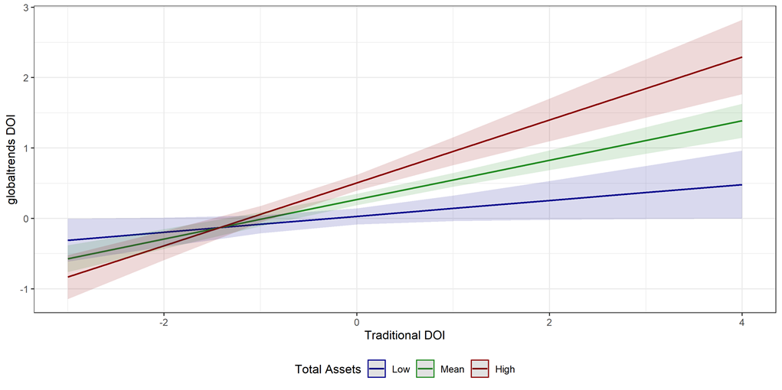
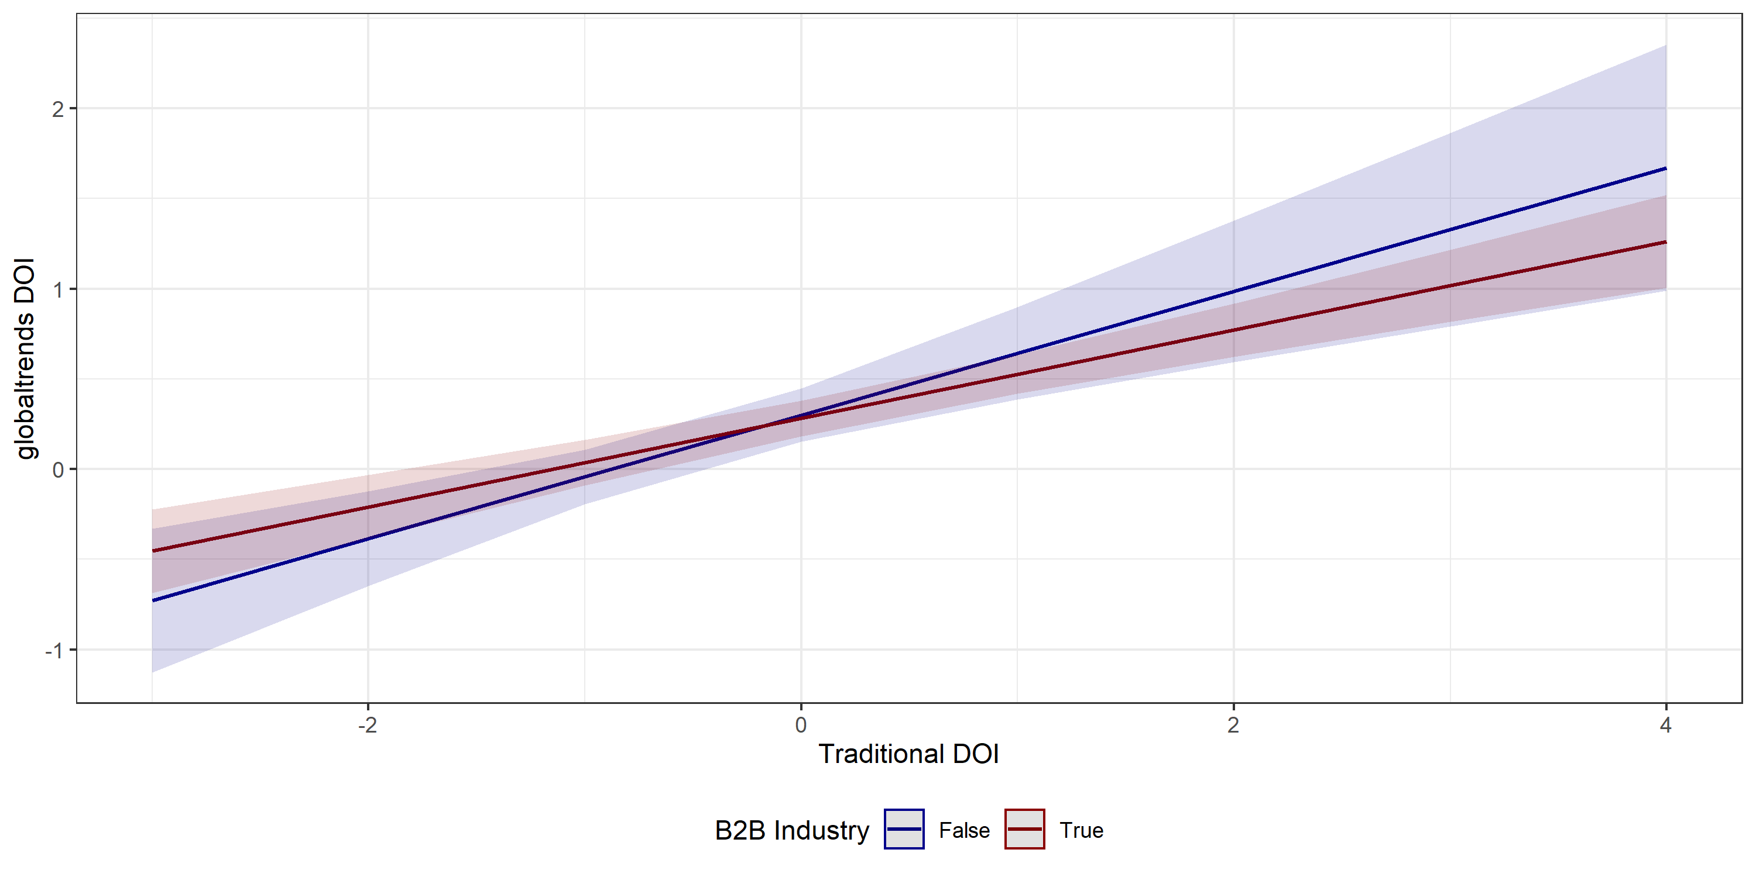
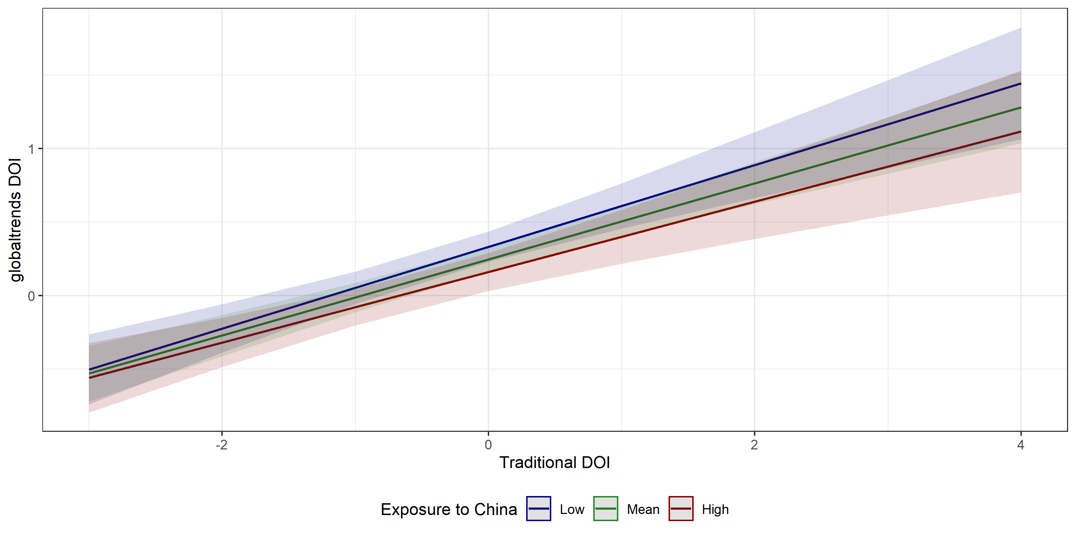
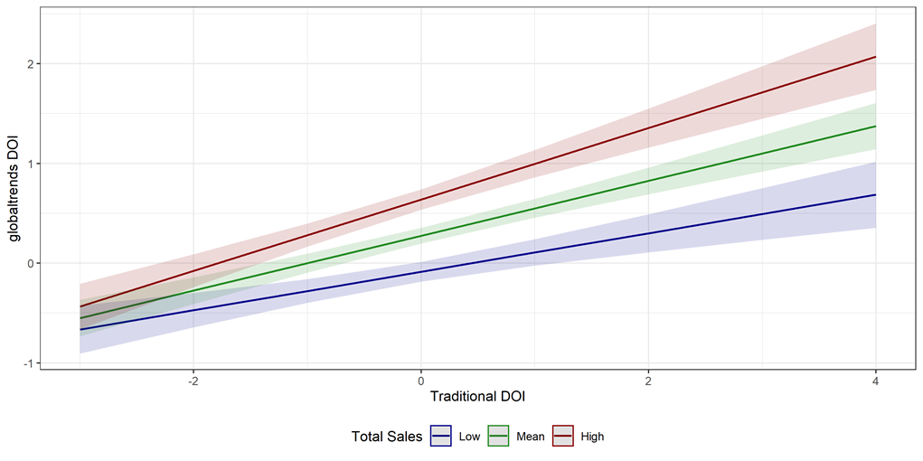
Firm biases
Firm size (assets)
B2B
Subsidiaries in China
Firm size (sales)

Slide 31
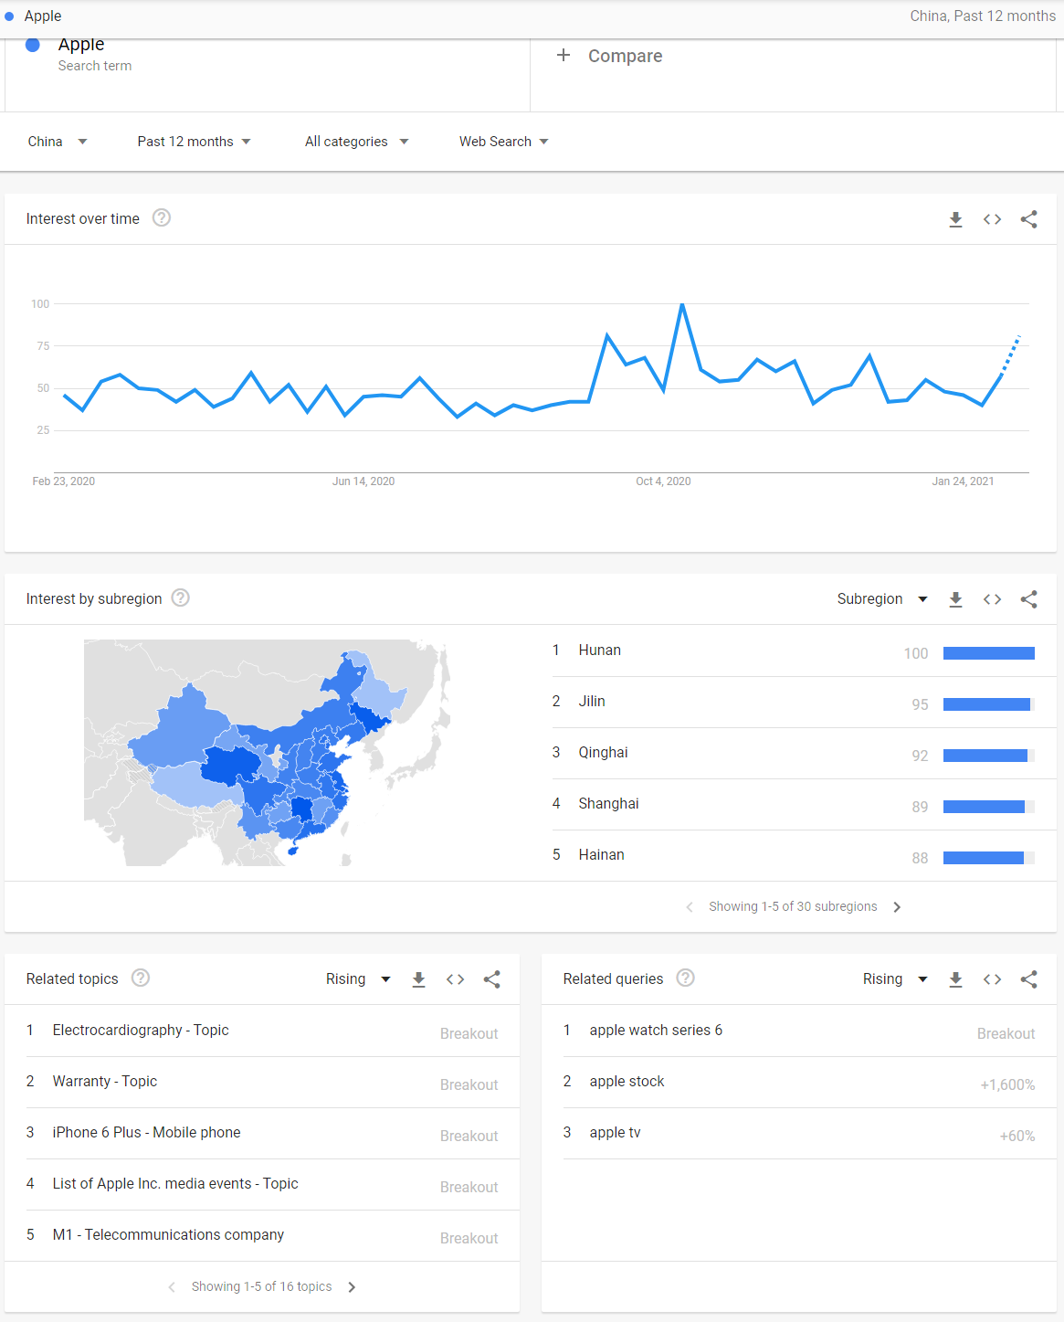
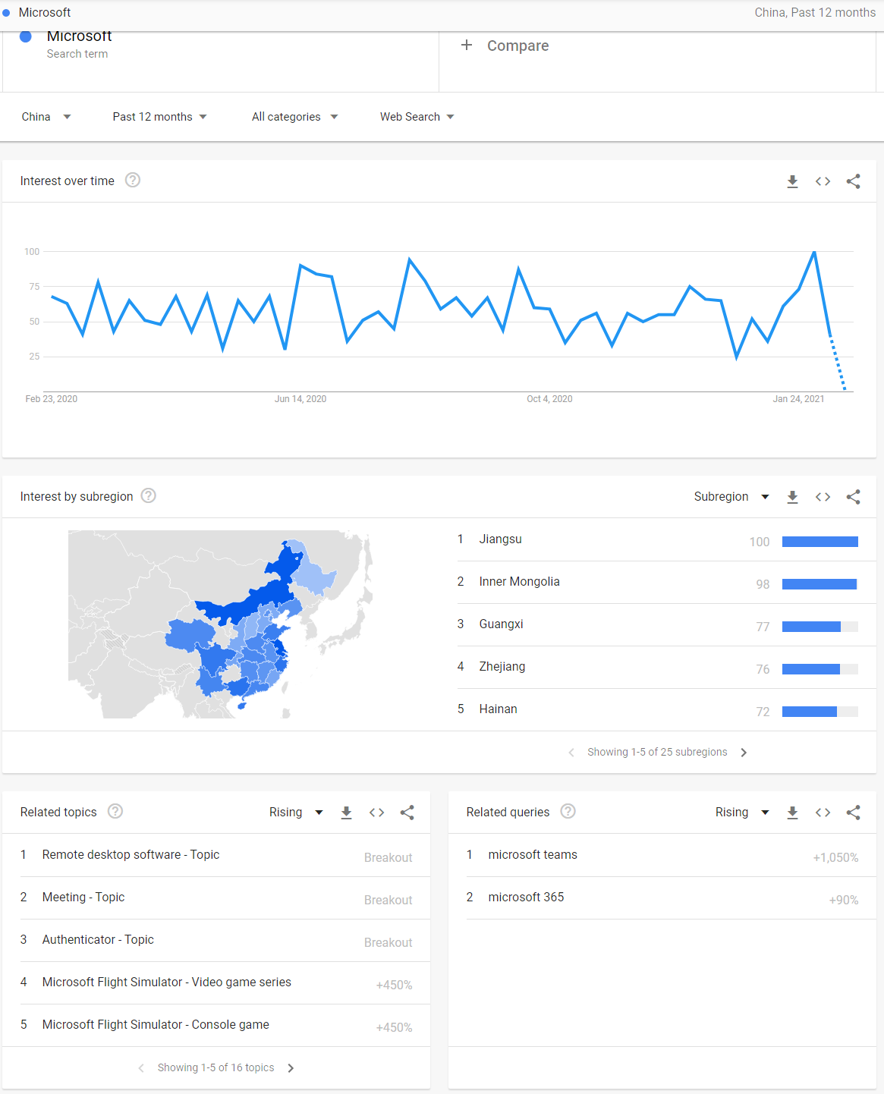
Google Trends results for China
https://trends.google.com/trends/explore?geo=CN&q=Apple https://trends.google.com/trends/explore?geo=CN&q=Microsoft

Slide 32
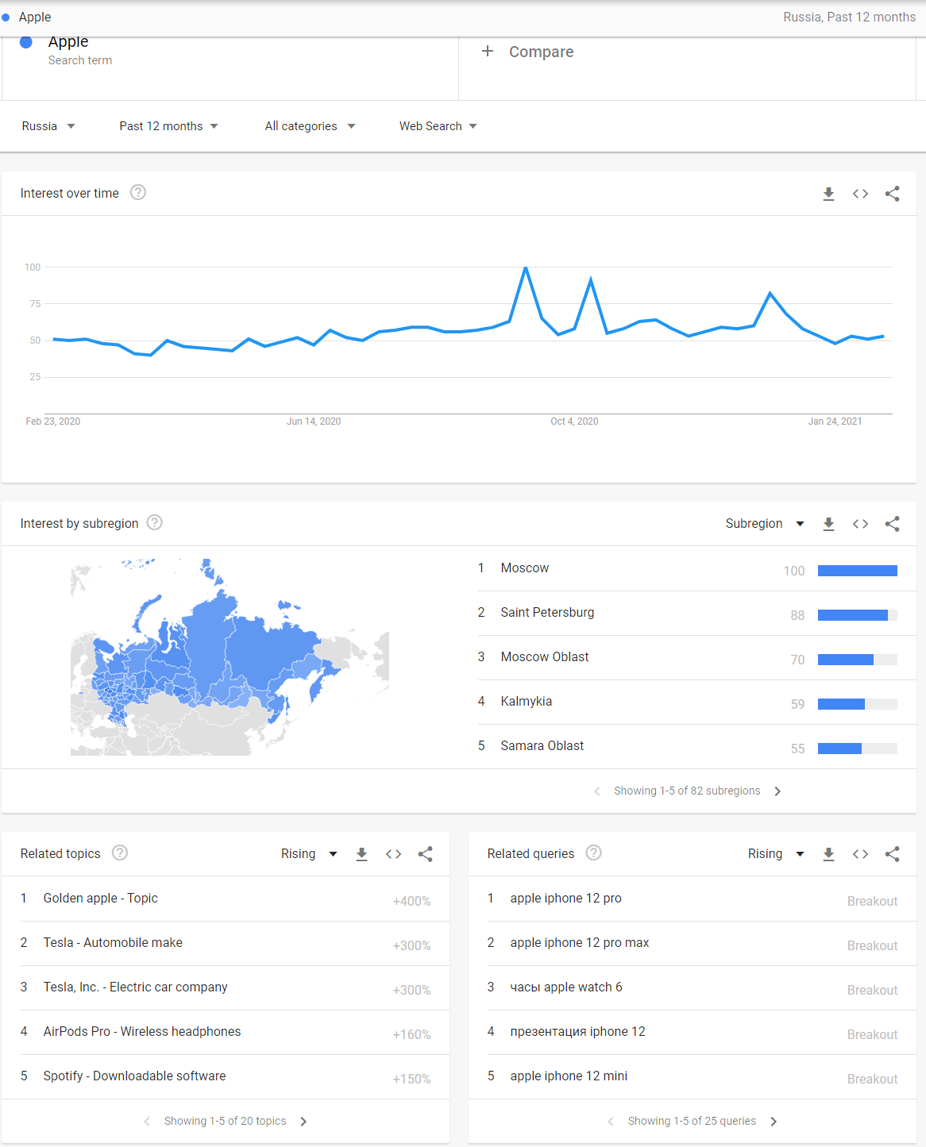
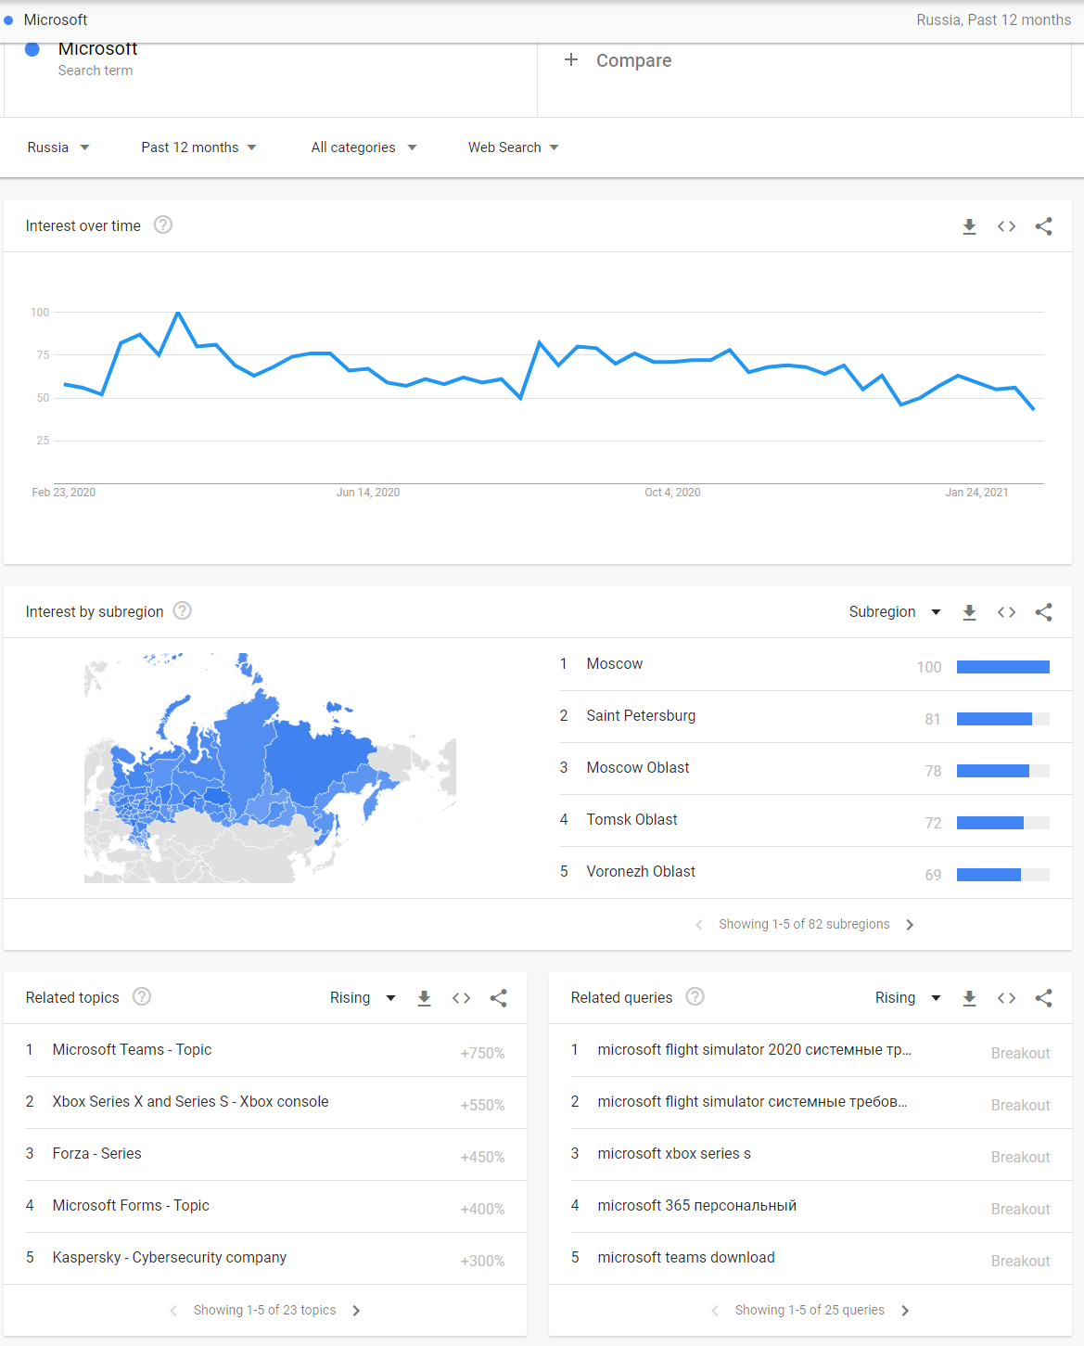
Google Trends results for Russia
https://trends.google.com/trends/explore?geo=RU&q=Apple https://trends.google.com/trends/explore?geo=RU&q=Microsoft

